Slide 1


DRAFT FINAL REPORT ON HYDRO-GEOLOGICAL
SURVEY UNDER MIRSHARAI UPAZILA DEVELOPMENT PLAN (MUDP)
Date: 14th October, 2018
URBAN DEVELOPMENT DIRECTORATE (UDD)
Ministry of Housing and Public Works
Government of the People’s Republic of Bangladesh
Presented By
Center for Geoservices and Research
Flat# GCA (Gr. Floor), House # 409,
Road # 06, Mirpur DOHS, Dhaka-1216.

Slide 2
Digital Elevation Model of the study area (Source:UDD) along with the locations of the monitoring wells

Slide 3
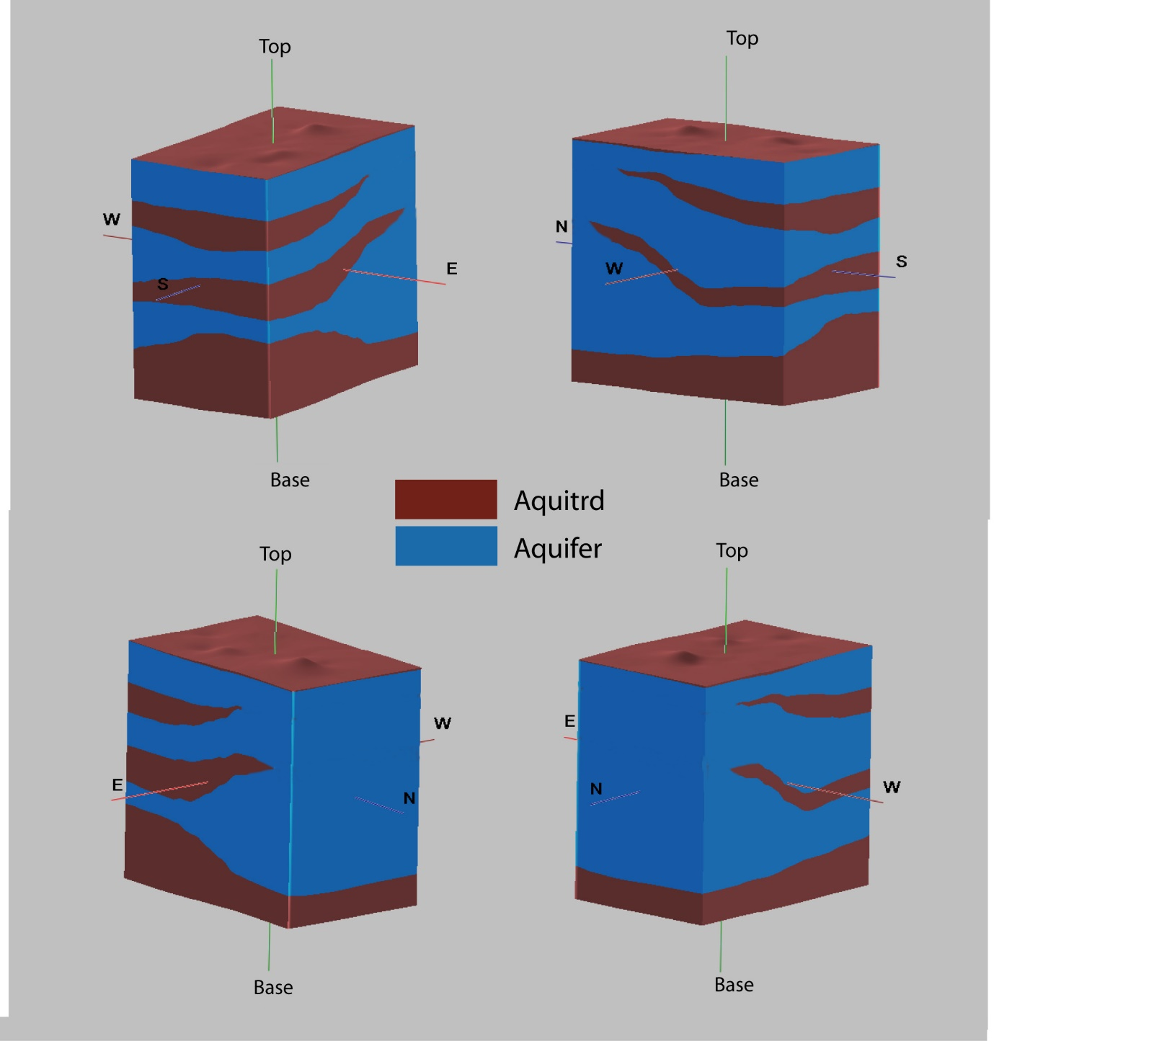
3D model of aquifer architecture

Slide 4
Isopach map of the shallow (1st) aquifer

Slide 5
Isopach map of the intermediate (2nd) aquifer

Slide 6
Isopach map of the deep aquifer

Slide 7
Cross section showing the vertical distribution of aquifer and aquitard

Slide 8
Fence diagram showing aquifer framework in the study area

Slide 9
Groundwater level contour of the shallow aquifer and deep aquifer

Slide 10
Groundwater level contour of the shallow aquifer and deep aquifer

Slide 11
Hydraulic properties derived from Grain Size analysis
Aquifer No. | Method
 | Slug Test |  |  |  | Grain Size Analysis
 | No. of Data | K [m/d] |  |  | No. of Data | K [m/d]
 |  | Average | Min. | Max. |  | Average | Min. | Max.
Aquifer-1 | 5 | 6.61 | 0.87 | 9.3 | 33 | 5.82 | 1.6 | 19
Aquifer-2 | Nill | - | - | - | 34 | 4.6 | 0.5 | 22
Aquifer-3 | 6 | 4.75 | 1 | 8.45 | 32 | 1.15 | 0.5 | 4.2

Slide 12
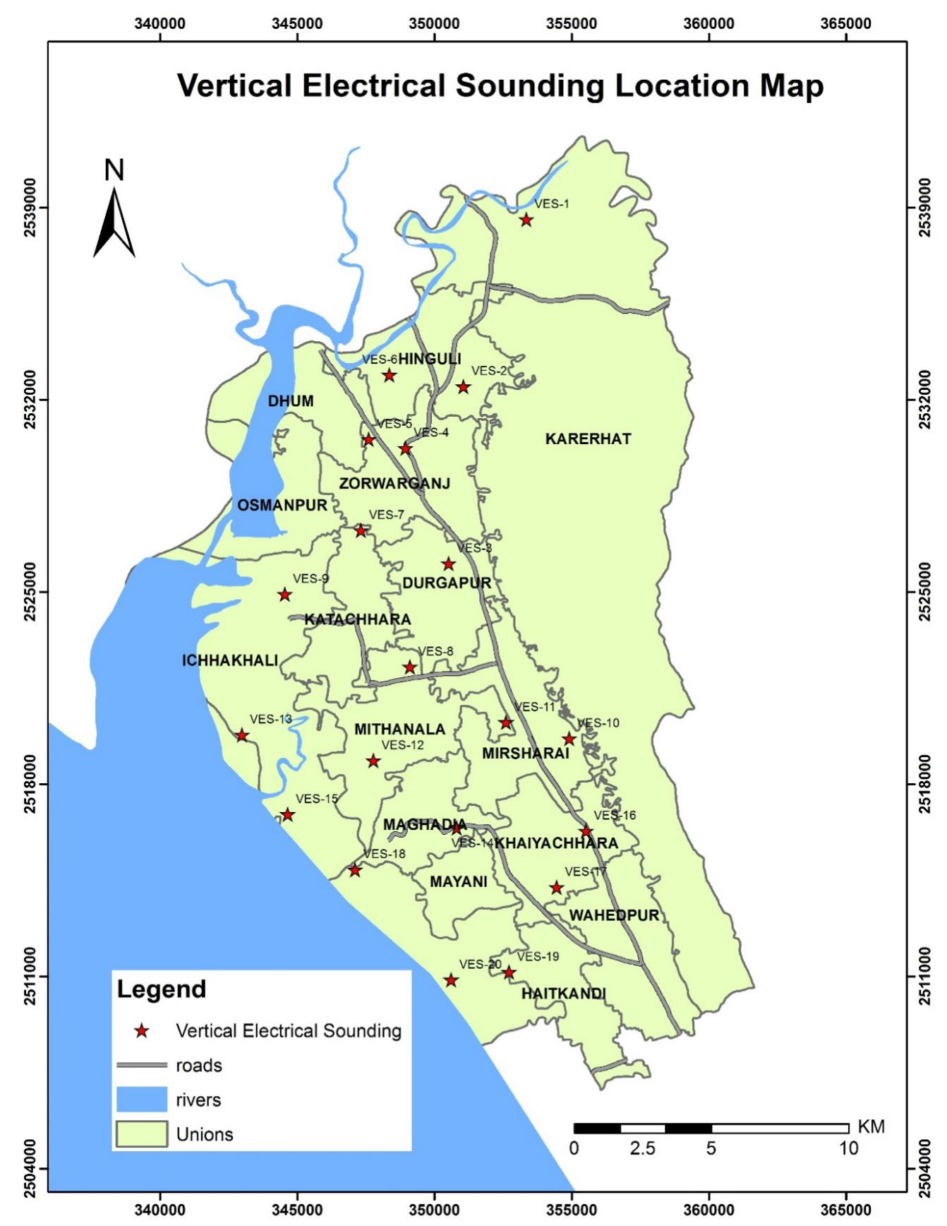
Vertical Electrical Sounding Locations in the project area

Slide 13
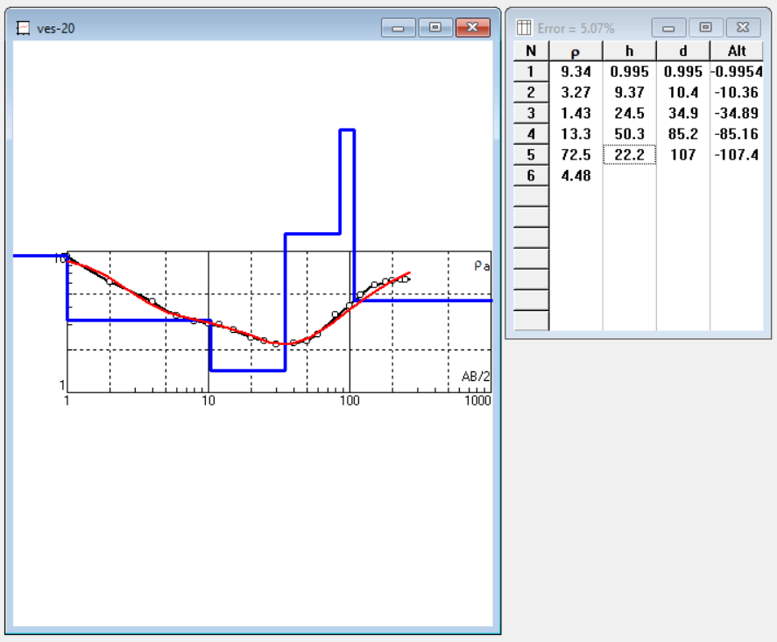
Vertical Electrical Sounding Output
Rho [ohm-m] | Thickness [m] | Depth [m] | Lithology
9.34 | 1 | 1 | Top soil
1.43-3.27 | 34 | 35 | Brackish Sand
13.3 | 50 | 86 | Clay
72.5 | 22 | 108 | FW Sand

Slide 14
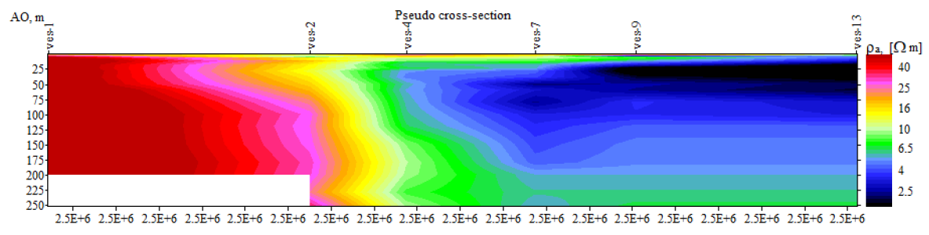
Resistivity pseudo section in north (VES-1) to south (VES-13) direction showing the extent of the brackish water in the shallow aquifer

Slide 15
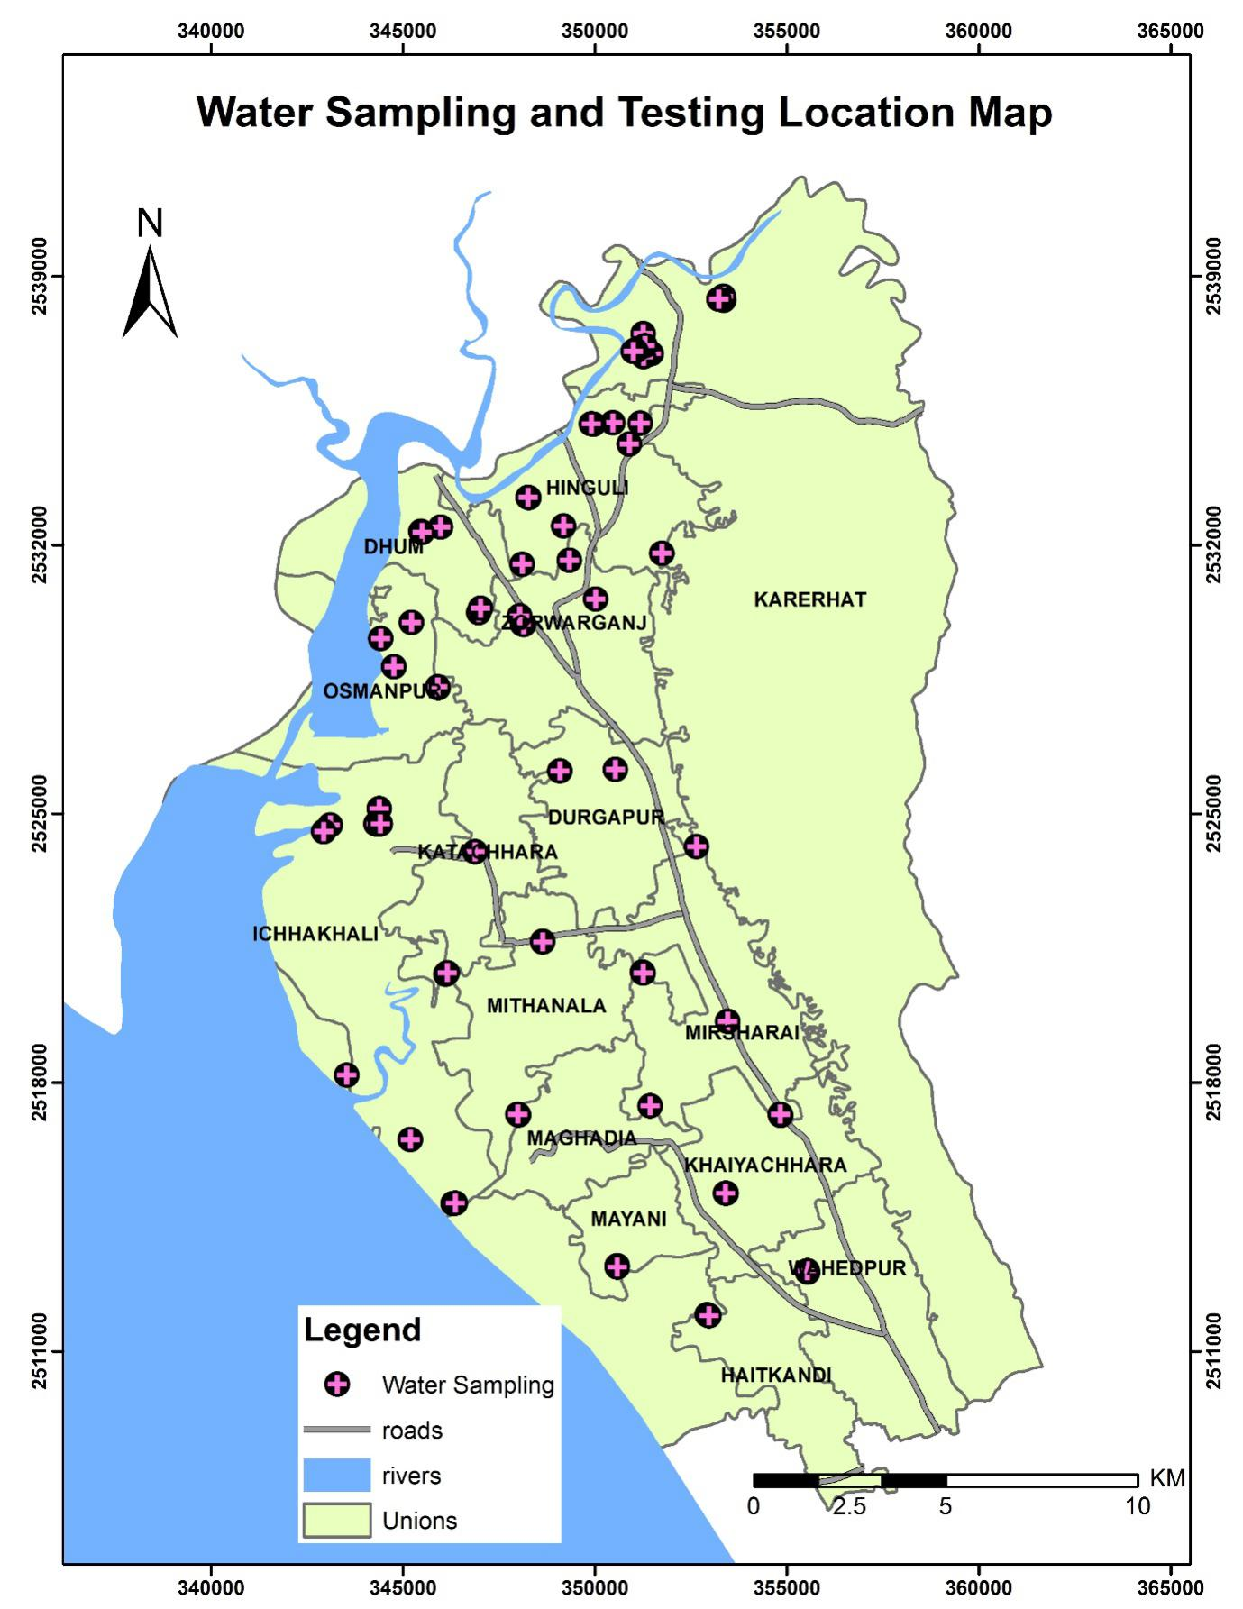
Water sampling and testing location map

Slide 16
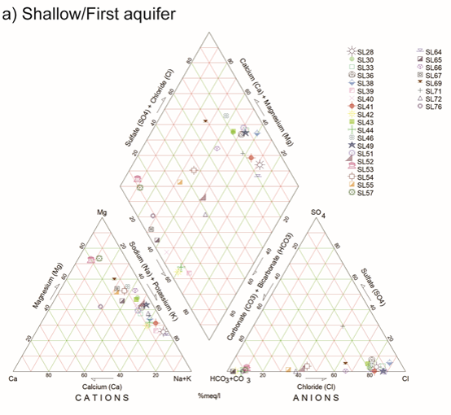
Shallow Aquifer Water quality
MgCO₃₋HCO₃ type to NaCl type
MgCO₃₋HCO₃ type indicates recently recharged water
NaCl type indicates seawater intrusion

Slide 17
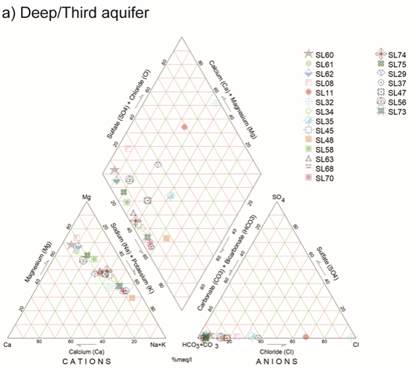
Deep Aquifer Water quality
Ca-K-Mg-CO₃-HCO₃ type indicates no effect
of seawater intrusion.
Na/K to Mg indicates longer residence time of water

Slide 18
Salinity map of Shallow and deep aquifer

Slide 19
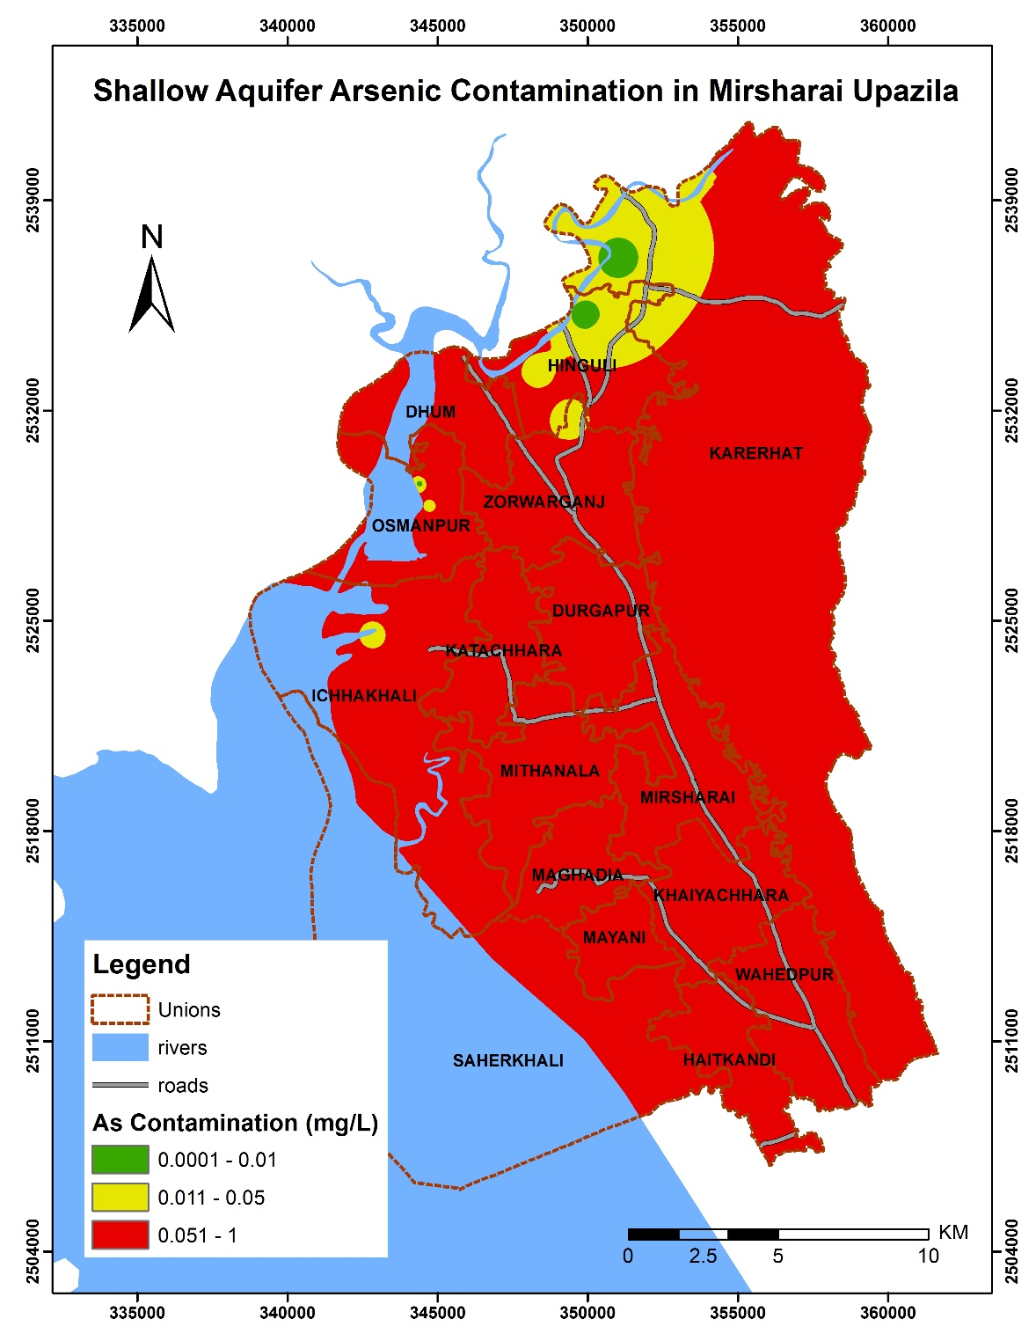
Arsenic Distribution map in Shallow aquifers

Slide 20
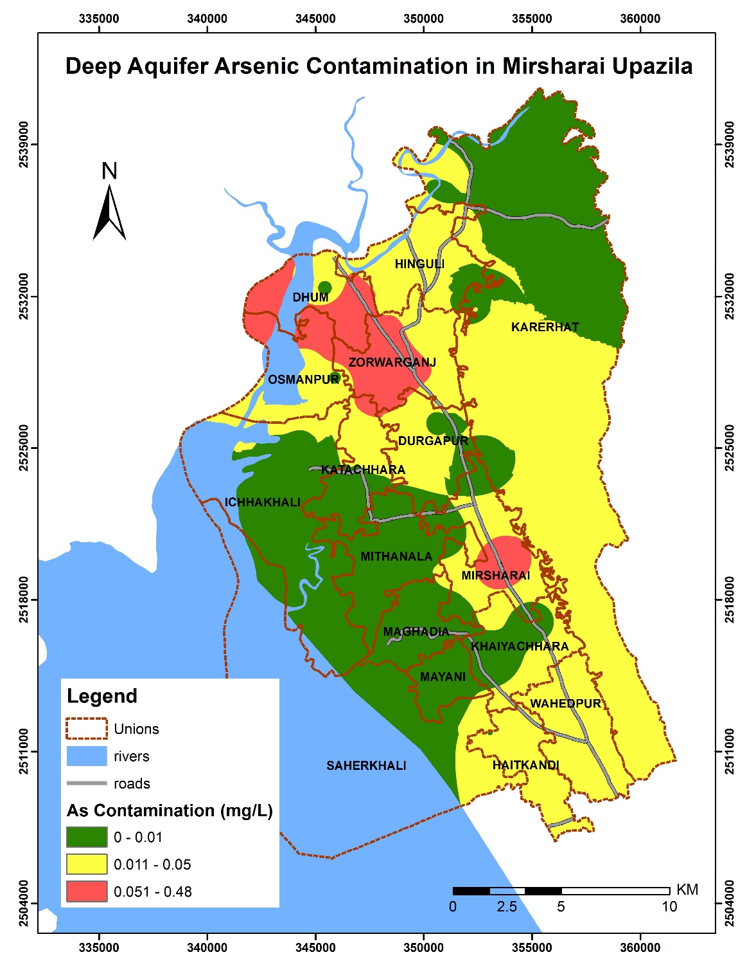
Arsenic Distribution map in Deep aquifers

Slide 21
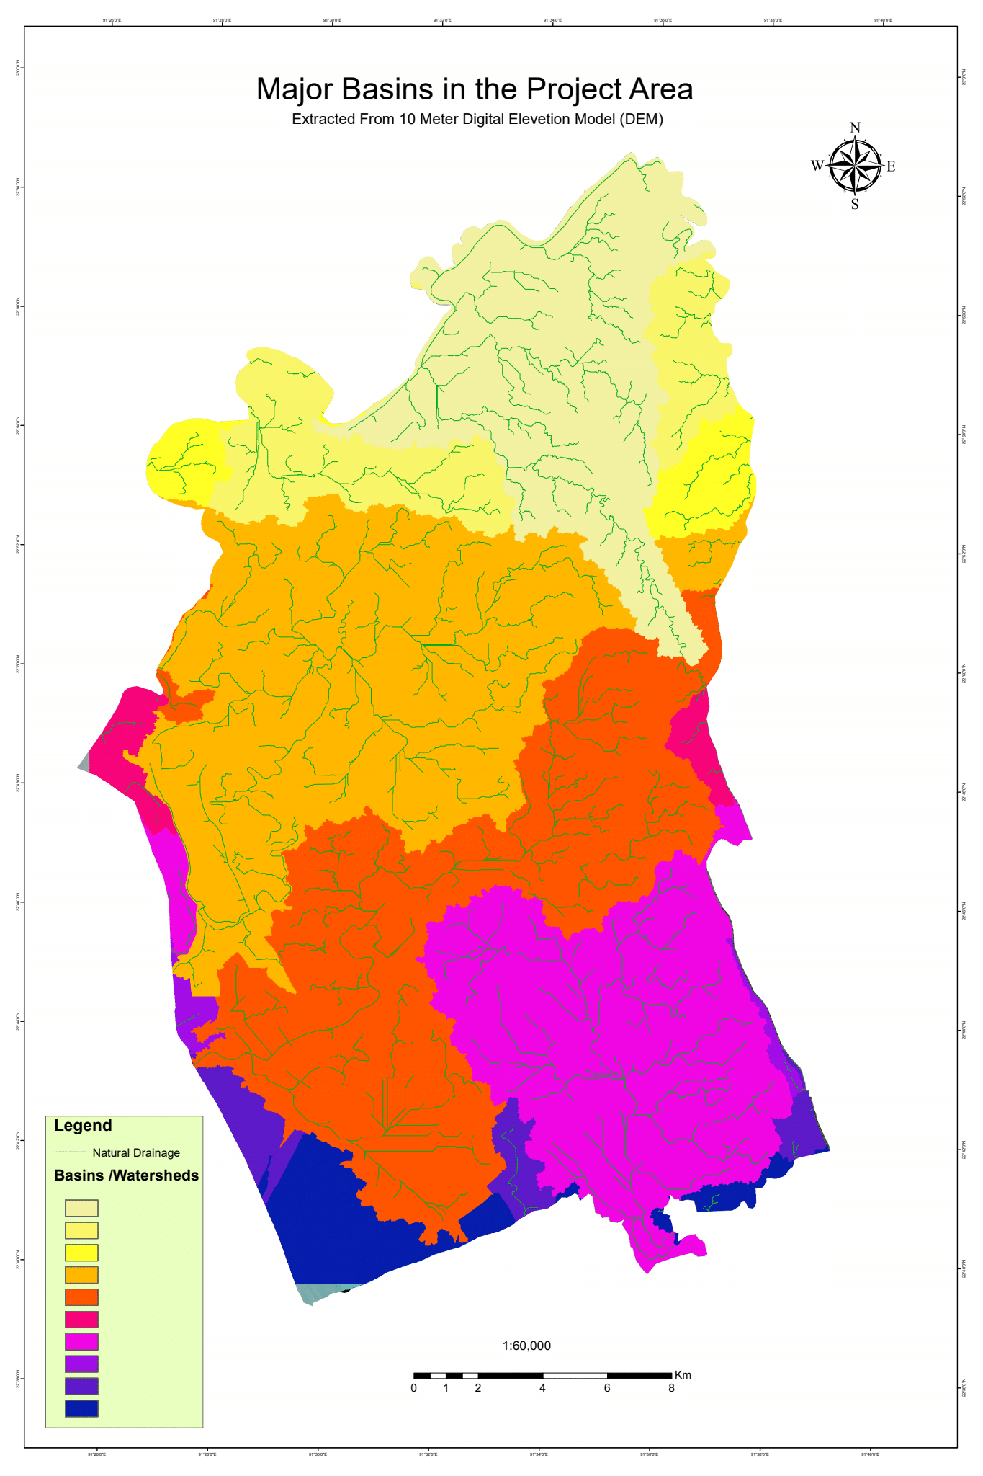
Major basin/watershed identified in the project area.

Slide 22
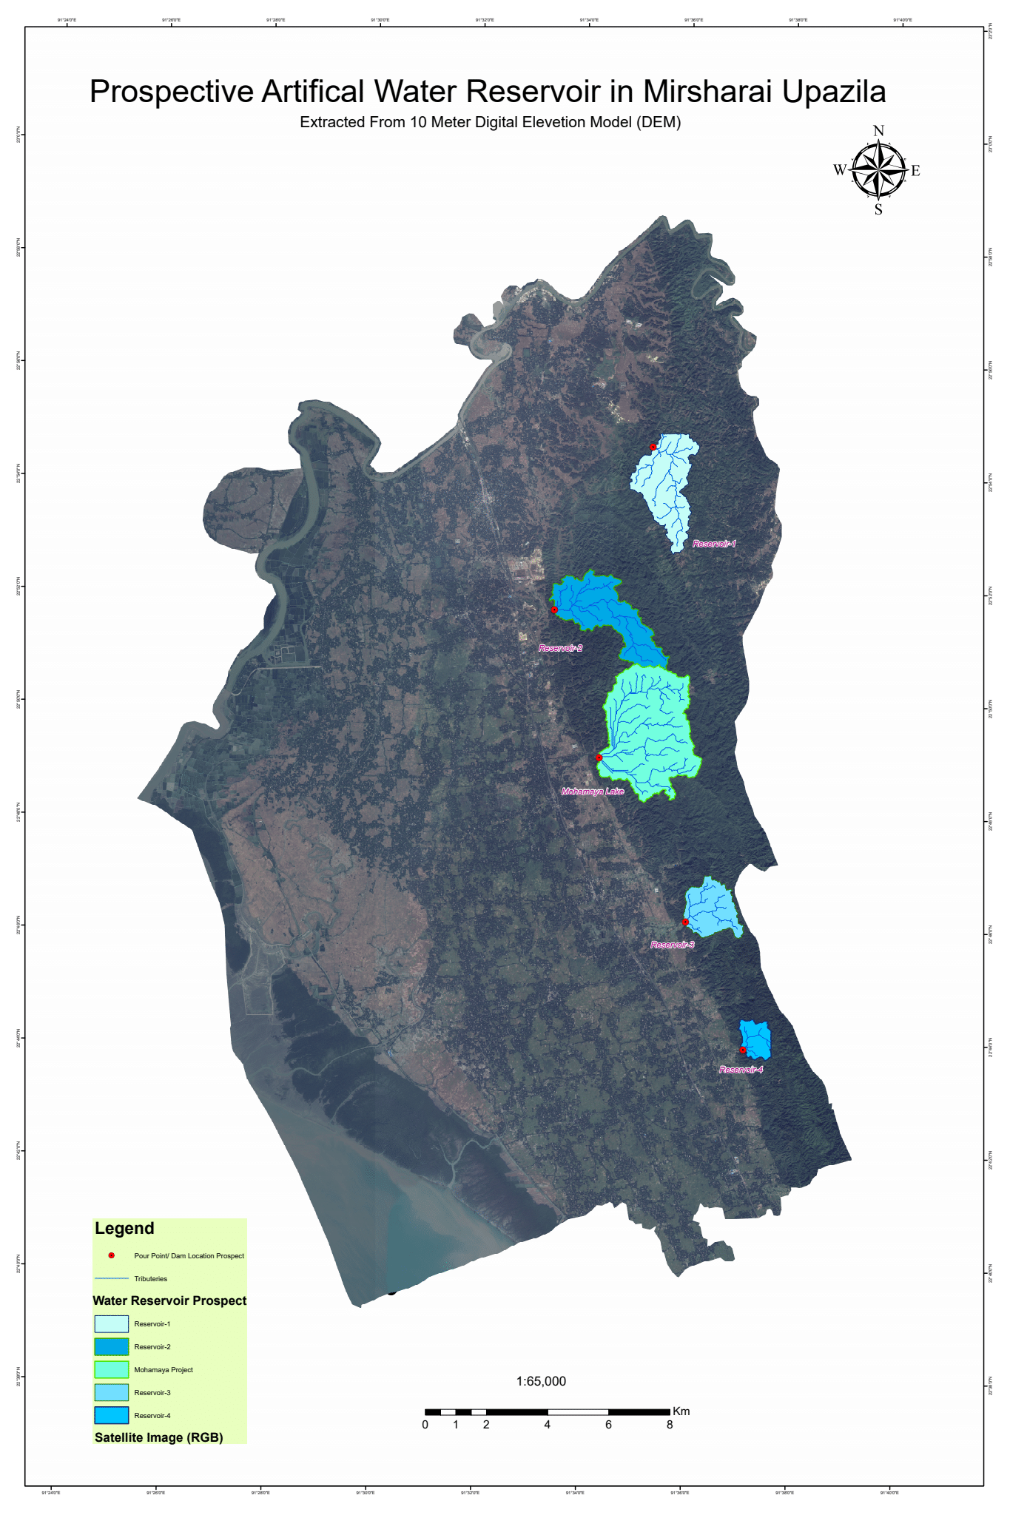
Prospective artificial reservoir locations

Slide 23
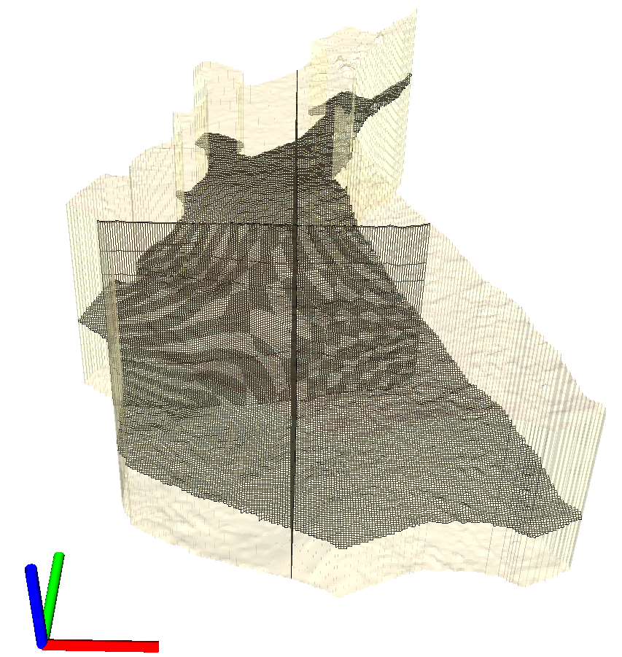
Groundwater Model Setup and discretization
The model consists of 345 rows and 210 columns, each 100 m in length and width, respectively,
resulting in a total number of 72450 cells per layer

Slide 24
Model layers and their hydraulic conductivities

Slide 25
Model simulated hydraulic head for- a) Shallow aquifer, b) intermediate aquifer, and c) the deep aquifer

Slide 26
Model simulated recharge rate in the study area

Slide 27
THANK YOU VERY MUCH!

