Slide 1
Presentation on Outcomes of
Traffic and Transport Surveys & Studies
(Package-4)
Preparation of Development Plan for Mirsharai Upazila, Chittagong District: Risk Sensitive Land use Plan (MUDP)
Urban Development Directorate (UDD)
Consultant:
DevConsultants Limited (DevCon), Bangladesh

Slide 2
Presentation Outline
Background
Objective
Traffic Surveys and Data Collection
Analyses and Results
Proposed Transportation Network
Travel Demand Model (CUBE 6.4.2)
Next Steps

Slide 3
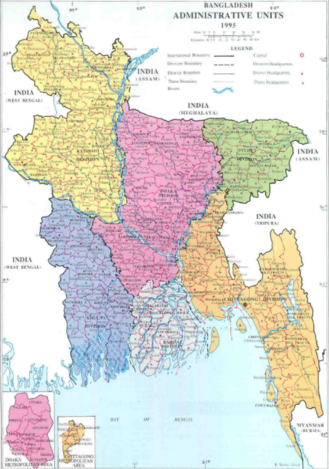
Background of the Study
Location
22°46.3′ North and 91°34.5′ East (Upazila HQ)
Area
482.88 sq. km
Goal:
  To prepare a development plan for Mirsharai Upazila addressing
  Existing Problems
  Update Land Use Plan
  Disaster Management
  Future Development:
    Economic Zones
    Eco-Tourism Development

Slide 4
Goal and Objectives
The GOAL of the project is to prepare a development plan for Mirsharai Upazila
    Objectives of the Assignment
Prepare integrated land use and transportation model for 20 years.
Prepare disaster management plan for Mirsharai from the perspective of transportation.
New and improved affordable and effective transportation network for Mirsharai.

Slide 5
Major Challenges
Moyamaya Tourism City
Department of Forest, Tourism and BWDB
Mirsharai Special Economic Zone and EPZ (7716 acres)
BEZA
Sitakunda Sea Port
and
Ramgarh land Port
Chittagong Port Authority
New Employment (50 lacs)
and
New Communication Facilities
Bangladesh Land Port Authority
BEPZA

Slide 6
Project Timeline and Staffing
Duration: 4 months
Experts Engaged:
Transport Planning Expert (Team Leader)
Moinul Hossain, PhD.
Transport Survey Expert
Md. Mizanur Rahman
Transport Survey Supervisor
Hamim Ahmed Muntakim (Project Coordinator)
Sultana Rajia

Slide 7
Traffic Surveys
Reconnaissance Survey- shortlisted locations throughout Mirsharai
Production (Household) Survey – 480+ Households in 16 Unions
Attraction Survey- 8 Locations
Traffic Count Survey - 10 Locations
Origin-Destination (OD) Survey – 10 Road-side Locations
Travel Time Survey – 7 Routes
Stakeholder Interview- Pourashava Mayors, Local People, BEZA, Tourist Spot authority, BEPZA, CNG operators/ owners)

Slide 8
Traffic Surveys and Data Collection

Slide 9
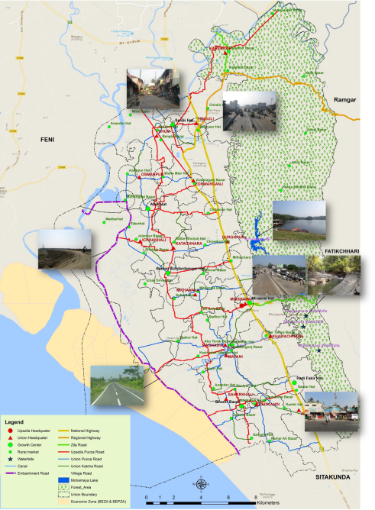
Reconnaissance Survey
Locations Visited:
Major Intersections (Highway and Local Roads)
Major Growth Centers and Bazars
Pourashava HQs
Ongoing Project Sites:
  Economic Zone – BEZA and BEPZA
  EZ Access Road (Sheikh Hasina Avenue) and Embankment Road- RHD
  Muhuri Project – BWDB
Tourist Spots; Mohamaya Lake, Khaiyachhara
Schools, Colleges, Industries

Slide 10
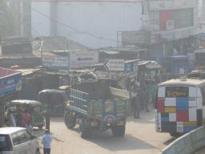
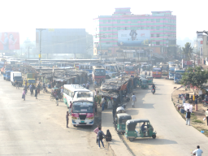
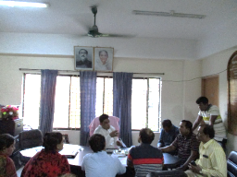
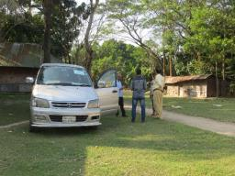
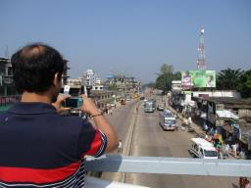
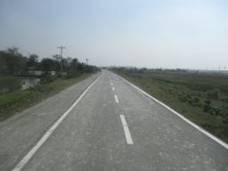
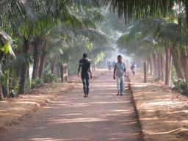
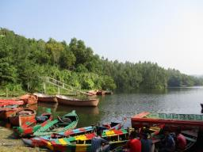
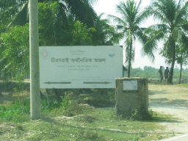
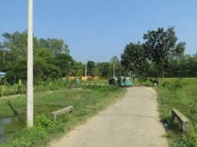
Reconnaissance Survey
Understanding Major Intersections of the Highway
Discussion with Mayor
Discussion with Local People
Visit to Economic Zone Site
Visit to the Tourist Spots

Slide 11
Literature Review
Projects | Source
Mirsharai –Teknaf Marine Drive Road Project | Report on Sustainable Transport System: A Road to Development (Ministry of Road Transport and Bridges Road Transport and Highways Division)
Cross-Border Road Network Improvement Project
Dhaka Chittagong Expressway Project on PPP Basis
Coastal Expressway from Shitakunda via Chittagong to Cox’ Bazar | Website of CDR International
Indo-Bangla Maitree Bridge from Sabroom to Ramgarh | Dhaka Tribune, Published on October 11, 2017 at 01:56 pm, by Shilajit Kar Bhowmic
Ramgarh Land Port | Bangladesh Land Port Authority (BLPA)
Sitakunda/ Mirsharai Sea Port | Chittagong Port Authority
Bay Container Terminal | The Daily Star and the Strategic Masterplan for Chittagong Port (ADB)
Construction of Double Line between Laksham-Chinki Ashtana, Mirsharai (JICA funded)-Ongoing | Master Plan, Bangladesh Railway Authority
Modernization of 11 Station’s Signaling System in between Chinki Astana, Mirsharai-Chittagong (EDCF)-Ongoing
Data | Source
Existing road network Growth center Rural market Administrative boundary Upazila and union headquarters | Local Government Engineering Department (LGED), Bangladesh
Basic Statistics: Present Activities
Population; Education; Employment Status; Household structure, Sanitation facilities and Drinking water facilities; Health; Commercial Activities; Transportation Facilities; Present Power Supply Situation and Telecommunication at Mirsharai | Bangladesh Bureau of Statistics (BBS), Feasibility Study Report for Mirsharai Economic Zone, Bangladesh Economic Zones Authority (BEZA)
Reports | Published By
Seventh Five Year Plan (FY2016 – FY2020): Accelerating Growth, Empowering Citizens | General Economics Division (GED) Planning Commission, GOB Published in December, 2015
Perspective Plan of Bangladesh (2010-2021): Making Vision 2021 a Reality | General Economics Division Planning Commission, GOB Published in April, 2012
Integration of Sustainable Development Goals into the 7th Five Year Plan | Support to Sustainable and Inclusive Planning (SSIP) Project General Economics Division (GED) Planning Commission Published in February, 2016
Feasibility Study Report for Mirsharai Economic Zone (BEZA) | Bangladesh Economic Zones Authority (BEZA) Published in July, 2014

Slide 12
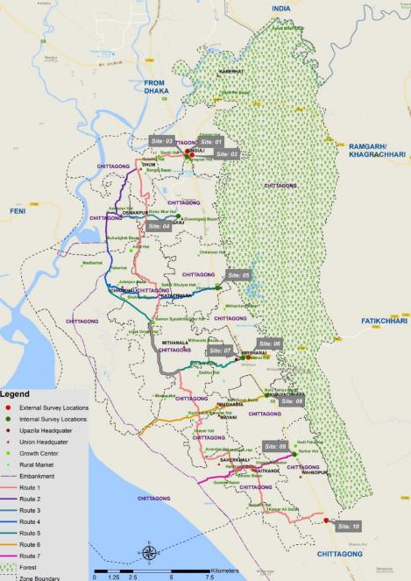
Traffic Count & OD Survey
Surveys in Mirsharai:
10 locations each for Origin-Desination and Vehicle Count Survey Locations
Site- 01: Baraiyarhat Intersection
Site- 02: Baraiyarhat Rail Crossing
Site- 03: Shantir Hat Road
Site- 04: Muhuri Project Road
Site- 05: Thakur Dighi Bazar
Site- 06: Fatikchhari Road
Site- 07: Mirsharai Paurashava
Site- 08: Bara Takiya Bazar (EZ Access)
Site- 09: Sarkar Hat
Site- 10: Boro Darogar Hat
4 External Stations:
Where external traffic is surveyed
6 Internal Stations:
Where internal traffic is surveyed
Method of Survey:
Video Data Count for Traffic Count Survey
and
Roadside Interview for O-D Survey
Survey outside Mirsharai:
Type of Survey: Video Data Count for Pedestrian and Vehicular Traffic
Location: Dhaka EPZ
Stations: 4

Slide 13
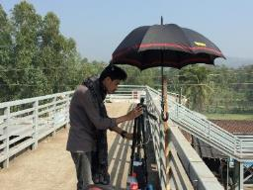
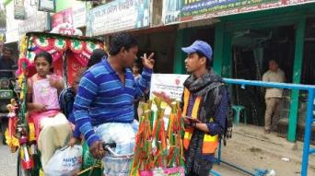
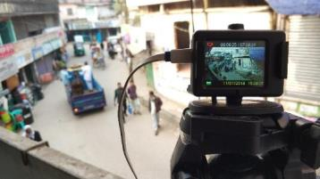
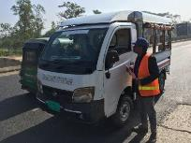
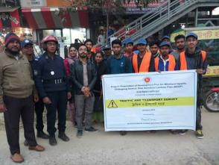
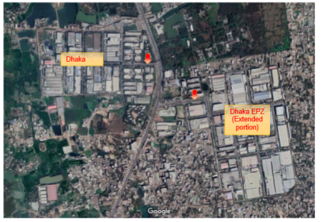
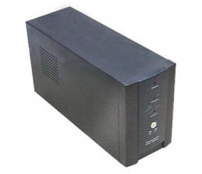
Traffic Count & OD Survey (Mirsharai)
Survey Activity
Instruments Used
EKEN 4K H9R camera
For 170 deg wide-angel shooting
Apollo 650VA UPS for continuous power backup
Consultants’ Supervisors,
Traffic Field Personnel and Surveyors (USAM)
Survey Locations at Dhaka EPZ

Slide 14
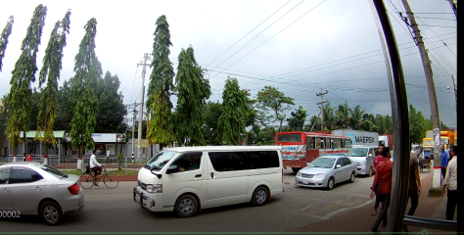
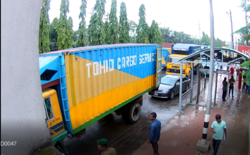
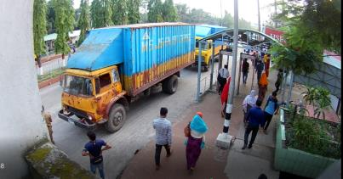
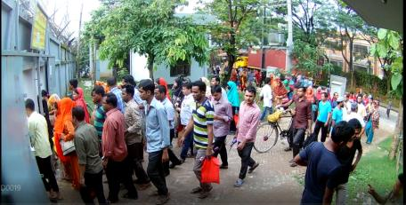
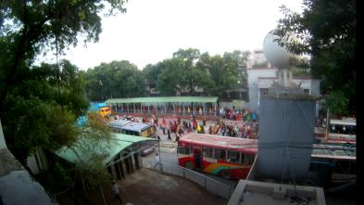
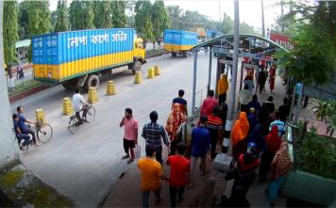
Traffic Count (Dhaka EPZ)
Survey Activity

Slide 15
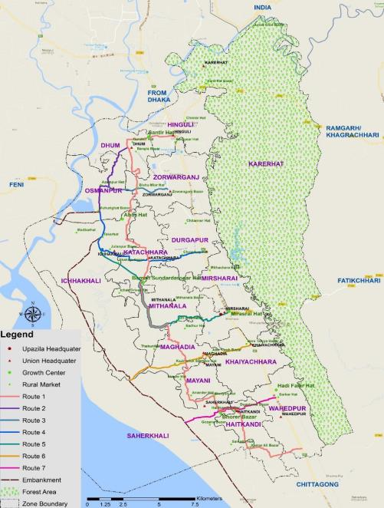
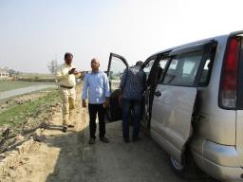
Travel Time Survey
Average Speed Method:
In this method the driver is instructed to travel at a speed that is judge to the representative of the speed of all traffic at the time.
No. of Routes:
7 selected routes (map)
Vehicle used:
Toyota NOAH model 2003

Slide 16
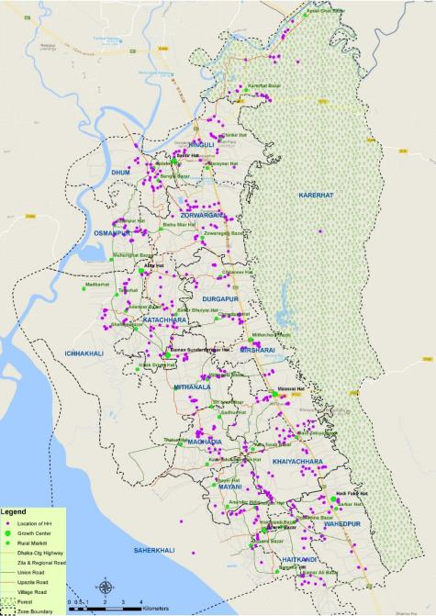
Household Survey
Sample Size: Minimum 30 from each Union
Sampling Criteria:
Income Category:
Low Income (below 15,000 tk)
Middle Income (15,000-30,000 tk)
High Income (above 30,000 tk)
Household Size:
Below or equal 3
4-5
Above 5
Special Features:
Comprehensive Questionnaire
GPS Survey
Equi-distribution of samples

Slide 17
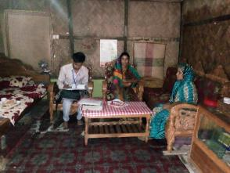
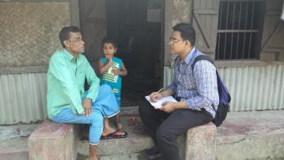
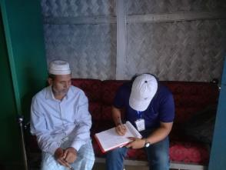
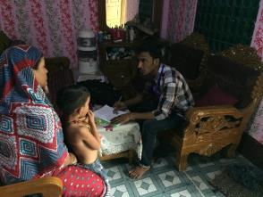
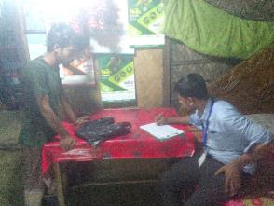
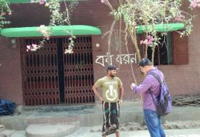
Household Survey
Household survey in Dhum
Household survey in Karerhat
Household survey in Osmanpur
Household survey in Hinguli
Household survey in Durgapur
Household survey in Zorawargonj

Slide 18
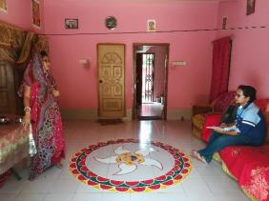
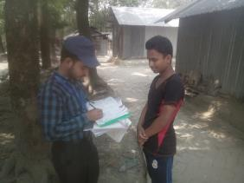
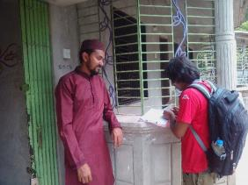
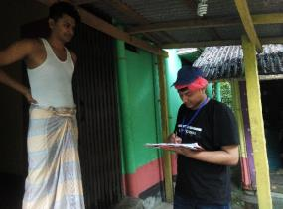
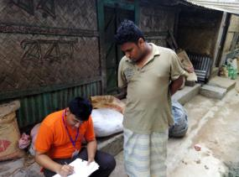
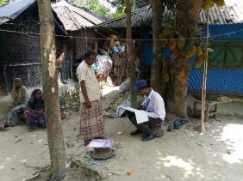
Household Survey
Household survey in Wahedpur
Household survey in Haitkandi
Household survey in Mithanala
Household survey in Ichhakhali
Household survey in Mirsharai
Household survey in Khaiyachhara

Slide 19
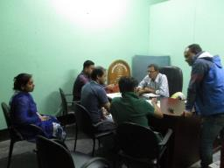
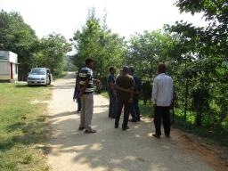
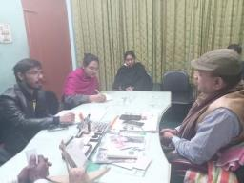
Stakeholder Interview
Sl. | Stakeholder Organization | Name & Designation of the Representative | Date of Meeting/ Interview
1. | USAM (University Students Association of Mirsarai) | Md. Nahid Mahamood, Co-founder | November 25, 2017
2. | Mirsharai Pourashava | Md. Gias Uddin, Hon. Mayor | November 25, 2017
3. | Mohamaya Eco Park Authorities | Md. Gholam Kabir, Forest Beat Officer, Forest Department Tour Operator, Mohamaya Eco Park Representatives of BWDB | November 26, 2017
4. | Baroiyar Hat Pourashava | Mr. Foyz Ahmed, Secretary to Mayor | November 26, 2017
5. | Local People of Mirsharai (Tea Stall Meetings) | Individuals/ groups at different locations, Mirsharai | November 25-26, 2017
6. | Baraiyarhat Pourashava | Md. Nizam Uddin, Hon. Mayor, Mr. Foyz Ahmed, Secretary to Mayor | January 10, 2018
7. | Local People of Mirsharai (Tea Stall Meetings) | Individuals/ groups at different locations, Mirsharai | Jan 06, 2018 to Jan 12, 2018
8. | BEPZA | Md. Hafizur Rahman, G.M (MIS) and Project Director (NARI) | March 11, 2018
9. | BEZA | Md. Abdul Quader Khan, Consultant (BEZA) | March 21, 2018
10. | BEZA Consultants (SHELTECH) | Mohammad Atikul Islam, Manager cum Planner Farzana Afroz, Junior Urban Planner | August 11, 2018

Slide 20
Attraction Survey (8 Locations)
Six Growth centers
Shantir Hat
Abur Hat
Baman Sundar darogar Hat
Mirsharai Hat
Hadi fakir Market
Shaherkhali Bhorer Bazar
Two Paurashavas
Mirsharai
Baraiyarhat
Selected facilities
Bazar
Government office
Private office
Shopping complex
Shops
Hospitals
Educational Institutions

Slide 21
Analyses and Results

Slide 22
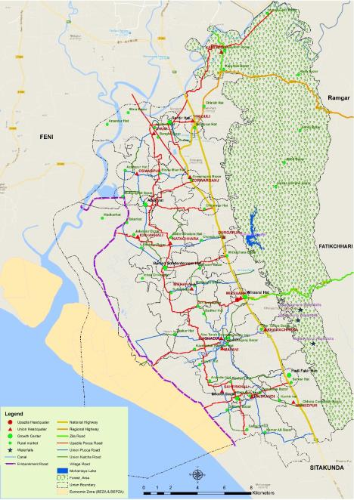
Reconnaissance Survey: Results
Existing Problems and Reasons
Congestion at Highways: Encroached service roads Uncontrolled parking Lack of law enforcement Heavy truck traffic during peak hours Lack of Public Bus, Leguna terminals
Congestion at Local Roads: Narrow roads Uncontrolled parking Roadside bazars Lack of designated CNG Stands
Other Problems: Narrow, zigzag local roads Lack of foot over-bridge use Vehicles taking wrong direction Insufficient public transport
Major Intersections with Highway:
Baraiyarhat
Chaitannerhat
Thakurdighi Bazar
Mirsharai
Bara Takiya
Sarkarhat
Public Transport Scenario:
Mainly used for long distance trips on National (N1) and Regional (R151) Highways
Other Public MUCM such as CNG, Auto-rickshaw/van ply on the internal roads

Slide 23
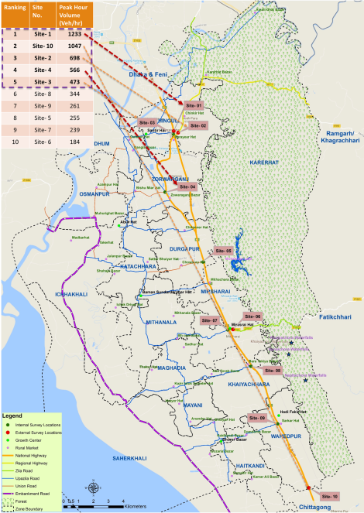
Traffic Count and OD Survey: Results
From Roadside OD it is observed:
National Highway: mainly has External-External trips
Regional highway (R151): highest trips are made within the zone.
Zilla road (Z1021): serves very few external trips because of its narrow width and congested opening and restriction for heavy traffic.
Internal trips are highest in Upazila Road
Ranking | Site No. | Peak Hour Volume (Veh/hr)
1 | Site- 1 | 1233
2 | Site- 10 | 1047
3 | Site- 2 | 698
4 | Site- 4 | 566
5 | Site- 3 | 473
6 | Site- 8 | 344
7 | Site- 9 | 261
8 | Site- 5 | 255
9 | Site- 7 | 239
10 | Site- 6 | 184
Peak Hour Vehicle Volume at:
National Highway (N1): 1000- 1250 veh.
Regional Highway (R151): 600- 700 veh.
Zila Road (Z1021): 170- 184 veh.
Upazila Road: 200- 600 veh.

Slide 24
Traffic Count Survey in Dhaka EPZ: Results
Category | Entrance | Exit | Total
Truck | 576 | 607 | 1183
Bus | 359 | 401 | 760
Car | 1290 | 1383 | 2673
Motor Cycle | 472 | 661 | 1133
Bicycle | 1617 | 2263 | 3880
Cycle Rickshaw | 81 | 79 | 160
Others | 189 | 198 | 387
Peak hour pedestrian volume: 25, 602
Peak hour vehicular volume: At the exit is 807 and 544 at the entry (vehicular traffic varies depending on the shifting hours)
Data collected in the month of Holly Ramadan. There is change of working shift

Slide 25
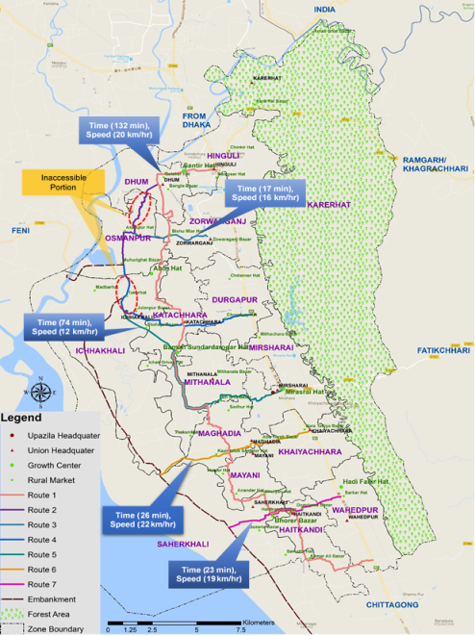
Travel Time Survey: Results
Route No. | Total travel time (hour) | Total distance (km) (from GIS map) | Average Speed (km/ hr)
Route 1 | 2.20 | 43.39 | 20
Route 2 | Inaccessible via passenger car due to bad road condition
Route 3 | 0.28 | 4.54 | 16
Route 4 | Inaccessible via passenger car due to bad road condition
Route 5 | 1.23 | 14.39 | 12
Route 6 | 0.43 | 9.46 | 22
Route 7 | 0.38 | 7.42 | 19
Survey stopped at Brindabonpur: Inaccessible from Azampur up to Embankment
Survey stopped at Julanpur Bazar: Inaccessible portion from Takerhat to Embankment

Slide 26
Household Survey: Results
Zone/ Union | Total No. of Trips per day | Avg. trips/ HH
Karerhat | 43989 | 5.98
Hinguli | 19440 | 2.74
Dhum | 15807 | 3.42
Zorawargonj | 29959 | 3.93
Osmanpur | 8052 | 2.64
Durgapur | 27498 | 4.98
Katachhara | 10077 | 2.31
Ichhakhali | 13546 | 2.60
Mirsharai | 13975 | 3.23
Mithanala | 12123 | 2.73
Shaherkhali | 12243 | 4.02
Maghadia | 28947 | 4.82
Khaiyachhara | 17633 | 3.61
Mayani | 14776 | 4.16
Wahedpur | 11789 | 2.48
Haitkandi | 9958 | 2.69
No. of trips per household: 3.52 trips (average)
Modal Share: Walk (58%), Auto-Rickshaw/CNG (27%), Bus (5%), Motor-cycle (0.1%), Bi-Cycle (4%), Rickshaw (1%) and Others (5%)
Major Purpose: Educational (21%), Work (18%) and Shopping (07%), Recreational (01%), Home Based (44%) and Others (09%)

Slide 27
Household Survey: Results
Distribution of Modal share and Purposes
Work | Educational | Shopping | Recreational | Home Based | Other | Zone/ Union | Walk | CNG | Bi-cycle | Rickshaw | Motor Cycle | Bus | Other
16% | 14% | 13% | 5% | 45% | 7% | Karerhat | 39% | 53% | 1% | 0% | 0% | 2% | 5%
16% | 30% | 6% | 0% | 48% | 0% | Hinguli | 77% | 19% | 0% | 0% | 0% | 4% | 0%
21% | 20% | 9% | 0% | 43% | 7% | Dhum | 45% | 39% | 0% | 2% | 0% | 8% | 5%
17% | 18% | 7% | 0% | 41% | 18% | Zorawargonj | 46% | 32% | 5% | 0% | 0% | 5% | 12%
20% | 20% | 0% | 0% | 40% | 20% | Osmanpur | 65% | 35% | 0% | 0% | 0% | 0% | 0%
23% | 21% | 6% | 0% | 50% | 0% | Durgapur | 31% | 33% | 0% | 0% | 2% | 15% | 20%
13% | 24% | 7% | 0% | 44% | 11% | Katachhara | 86% | 6% | 9% | 0% | 0% | 0% | 0%
11% | 30% | 13% | 1% | 45% | 0% | Ichhakhali | 73% | 20% | 5% | 3% | 0% | 0% | 0%
25% | 21% | 4% | 2% | 46% | 2% | Mirsharai | 76% | 10% | 6% | 2% | 0% | 3% | 3%
25% | 13% | 6% | 0% | 44% | 13% | Mithanala | 80% | 20% | 0% | 0% | 0% | 0% | 0%
7% | 24% | 13% | 0% | 43% | 12% | Shaherkhali | 86% | 7% | 7% | 0% | 0% | 0% | 0%
18% | 25% | 3% | 0% | 46% | 8% | Maghadia | 61% | 18% | 13% | 0% | 0% | 1% | 7%
12% | 15% | 16% | 1% | 41% | 14% | Khaiyachhara | 33% | 43% | 0% | 4% | 0% | 20% | 0%
24% | 24% | 1% | 0% | 48% | 3% | Mayani | 56% | 21% | 6% | 0% | 0% | 10% | 7%
27% | 13% | 4% | 0% | 44% | 13% | Wahedpur | 60% | 31% | 5% | 3% | 0% | 0% | 1%
11% | 20% | 9% | 0% | 37% | 23% | Haitkandi | 55% | 24% | 13% | 3% | 0% | 5% | 0%

Slide 28
Household Survey: Results
Zone/ Union | Avg. Travel Cost (tk.) | Avg. Trip Length (minutes)
Karerhat | 10 | 22
Hinguli | 3 | 17
Dhum | 29 | 27
Zorawargonj | 6 | 18
Osmanpur | 5 | 19
Durgapur | 14 | 26
Katachhara | 4 | 14
Ichhakhali | 4 | 16
Mirsharai | 3 | 15
Mithanala | 3 | 20
Shaherkhali | 1 | 21
Maghadia | 5 | 20
Khaiyachhara | 17 | 34
Mayani | 6 | 25
Wahedpur | 5 | 19
Haitkandi | 4 | 22
Average travel cost (tk.) and trip length (min)

Slide 29
Household Survey: Results
Ranking for Intra-Zonal Trips
Ranking for Inter-Zonal Trips
Top 10 OD Pairs (inter-zonal trip)
Zone Ranking | Zone Name | Intra-zonal Trips (%)
1 | Hinguli | 98
2 | Wahedpur | 95
3 | Mirsharai | 89
4 | Ichhakhali | 88
5 | Karerhat | 84
6 | Katachhara | 80
7 | Maghadia | 79
8 | Mithanala | 78
9 | Zorawargonj | 70
10 | Haitkandi | 59
11 | Osmanpur | 58
12 | Durgapur | 53
13 | Shaherkhali | 52
14 | Dhum | 51
15 | Mayani | 39
16 | Khaiyachhara | 17
Zone Ranking | Zone Name | Inter-zonal Trips (%)
1 | Khaiyachhara | 83
2 | Mayani | 61
3 | Dhum | 49
4 | Shaherkhali | 48
5 | Durgapur | 47
6 | Osmanpur | 42
7 | Haitkandi | 41
8 | Zorawargonj | 30
9 | Mithanala | 22
10 | Maghadia | 21
11 | Katachhara | 20
12 | Karerhat | 16
13 | Ichhakhali | 12
14 | Mirsharai | 11
15 | Wahedpur | 5
16 | Hinguli | 2
Zone | Trip (%) | Zone | Ranking
Khaiyachhara | 29 | Mirsharai | 1
Dhum | 15 | Hinguli | 2
Osmanpur | 14 | Zorwarganj | 3
Durgapur | 13 | Mirsharai | 4
Haitkandi | 12 | Wahedpur | 5
Zorawargonj | 11 | Hinguli | 6
Mithanala | 10 | Mirsharai | 7
Shaherkhali | 10 | Haidkandi | 8
Mayani | 10 | Maghadia | 9
Maghadia | 7 | Mirsharai | 10

Slide 30
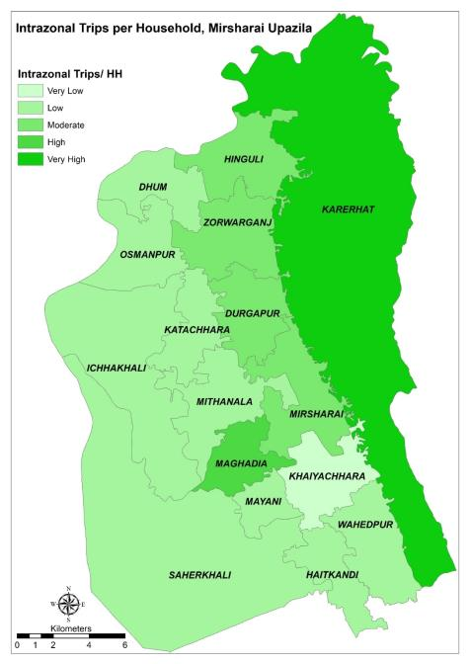
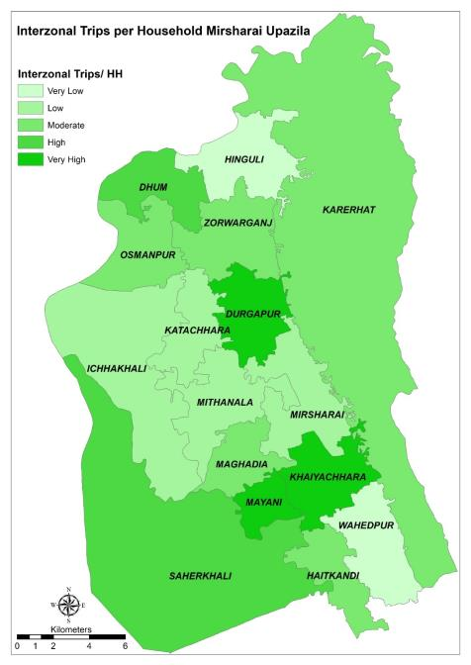
Household Survey: Results

Slide 31
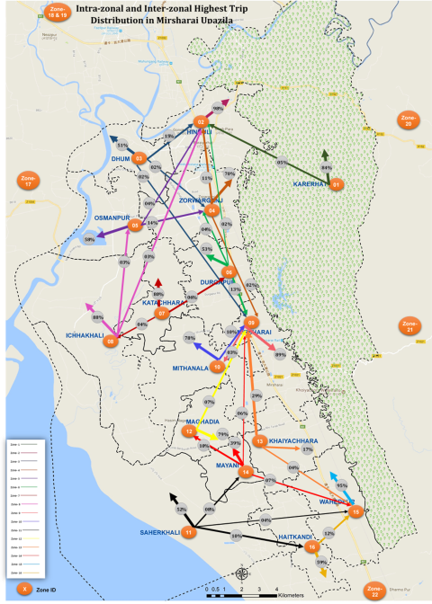

Household
Survey: Results

Slide 32
Household Survey: Results
Strengths: Comparison of Zones based on Intra-zonal Trip Purpose
Zone Name/ ID |  | Karerhat (1) | Hinguli (2) | Dhum (3) | Zorawarganj (4) | Osmanpur (5) | Durgapur (6) | Katachhara (7) | Ichhakhali (8) | Mirsharai (9) | Mithanala (10) | Shaherkhali (11) | Maghadia (12) | Khaiyachhara (13) | Mayani (14) | Wahedpur (15) | Haitkandi (16)
Purpose | Work | Very High | Moderate | Very Low | Moderate | Low | High | Low | Low | Very High | High | Very Low | Very High | Very Low | Low | Very High | Very Low
 | Educational | High | Very High | Low | High | Low | High | Moderate | High | Moderate | Very Low | High | Very High | Very Low | Low | Low | Very Low
 | Shopping | Very High | Moderate | Very High | Moderate | Very Low | Low | Low | High | Low | Low | Moderate | Moderate | Very Low | Low | Low | Moderate
 | Recreational | Very High | Very Low | Very Low | Very Low | Very Low | Very Low | Very Low | Very Low | Low | Very Low | Very Low | Very Low | Very Low | Very Low | Very Low | Very Low
 | Others | Moderate | Very Low | Low | Very High | Very High | Very Low | Moderate | Very Low | Very Low | High | Moderate | Moderate | Moderate | Low | High | Very High

Slide 33
Household Survey: Results
Deficiencies: Comparison of Zones based on Inter-zonal Trip Purpose
Zone Name/ ID |  | 1 | 2 | 3 | 4 | 5 | 6 | 7 | 8 | 9 | 10 | 11 | 12 | 13 | 14 | 15 | 16
 |  | Karerhat | Hinguli | Dhum | Zorawarganj | Osmanpur | Durgapur | Katachhara | Ichhakhali | Mirsharai | Mithanala | Shaherkhali | Maghadia | Khaiyachhara | Mayani | Wahedpur | Haitkandi
Purpose | Work | Moderate | Very Low | Very High | Moderate | High | Very High | Very Low | Low | Very Low | Low | Low | Moderate | High | Very High | Very Low | Moderate
 | Educational | Low | Very Low | Moderate | Very Low | Low | High | Very Low | Very Low | Low | Very Low | High | Low | High | Very High | Very Low | Moderate
 | Shopping | Very Low | Very Low | Very Low | Low | Very Low | Low | Very Low | Very Low | Very Low | Very Low | Moderate | Very Low | Very High | Very Low | Very Low | Very Low
 | Recreational | Very High | Very Low | Very Low | Very Low | Very Low | Very Low | Very Low | Very Low | Very Low | Very Low | Very Low | Very Low | Moderate | Very Low | Very Low | Very Low
 | Others | Moderate | Very Low | Moderate | High | Low | Very Low | Low | Very Low | Low | Very Low | Very High | Moderate | Very High | Very Low | Very Low | Moderate

Slide 34
Stakeholder Interview: Results
Road Network:
Widening of the Mirsharai-Fatikchhari Road (Z1021) for regional connectivity
Improvement of Regional Highway R151 for better connection to the Ramgarh Land Port
Accommodation of good drainage system along with road design
A flyover at Baraiyarhat intersection to reduce congestion
Zorwarganj-Borburia Ghat Road for regional connectivity and bypassing traffic of EZ from Mirsharai
Pedestrian’s safety has to be ensured with necessary facilities and law enforcement
Public Transport Facility:
Better access to public transport and walking facility for the local people
Designated terminals for public bus, pick-ups, rent-a-cars, and other UCMs/ NMVs
Tourist Spots:
Increased and safer accessibility to and in between the tourist spots
Provision of Parking facility in the tourist spots

Slide 35
Stakeholder Interview: Results
Economic Zone:
The Land Use of Mirsharai EZ will generate 17 times more traffic than that of DEPZ (BEZA and BEPZA indication)
Rail alignment through the EZ such as Fazilpur- Mirsharai Economic Zone-Sitakundo
Possible options for accessing the EZ site
  Hinguli-Santir Hat-Dhum-Azampur Hat-Muhurighat Bazar-EZ Embankment;
  Zorwarganj-Bishu Miar Hat- Azampur Hat-Muhurighat Bazar-EZ Embankment;
  Mithachhara to Embankment via Baman Sundar Hat GC;
  Thakur Dighi Bazar to EZ embankment through Chowdury Hat and Julanpur Bazar (Ichhakhali)
  Dhumghat bridge-Golakar Hat-Azampur Hat to EZ via Muhurighat Bazar

Slide 36


Travel Demand Forecasting Model
(4- step model)
Tool Used
Citilabs CUBE 6.4.2

Slide 37
Why did we use CUBE for Model Construction?
Citilabs CUBE is a market leading software tool used for transportation planning.
  Citilabs is a US based company but has offices in:
  More than 2500 urban areas have been modelled with CUBE
  SELECTED KEY CITIES: Dublin, Edinburgh, London, Paris, Marseille, Melbourne, Milan, Moscow, Abu Dhabi, Los Angeles, Atlanta
  SELECTED KEY NATIONAL GOVERNMENTS: Ireland, Scotland, England, Netherlands, Belgium, France, Spain, Italy, Norway, Sweden, Thailand, Taiwan
Several major infrastructural projects in Bangladesh have used CUBE, e.g., RSTP, Dhaka Elevated Expressway, East West Elevated Expressway, Dhaka By-Pass PPP Project, CPA Bay Terminal, etc.
Bangladesh Road Research Laboratory has a full scale CUBE based transportation planning laboratory
The software can directly take GIS files and input and produce outputs as GIS files. Almost all the mapping activities in Bangladesh use GIS.
Several consulting companies have CUBE, i.e., experts are available locally
Can be purchased locally and technical support is also available locally
Munich Manchester Milan San Francisco
Bangkok Beijing Singapore

Slide 38

Application Dashboard

Slide 39



Input Road Network with TAZs

Slide 40



Trip Generation

Slide 41



Trip Distribution – Work Trips

Slide 42


Trip Distribution – Non-Work Trips

Slide 43


Mode Choice (car means PCU)

Slide 44

Network Assignment

Slide 45

Network Assignment – connected with ArcGIS Online

Slide 46


Network Assignment
Preferred Route Between Two Zones
Source of traffic for a specific link

Slide 47
Proposed Future Road Network
The proposed transportation network is proposed based on the assumption that the BEPZA and BEZA will generate 17 times (3 times from EPZ, 10 times from EZ and 20% induced generation more traffic than that being generated at present in Dhaka EPZ and the initially proposed transportation network should be able to sustain that traffic as well as the existing traffic in Mirsharai during peak hours
Design Criteria
During peak hours, the pedestrian demand will be around 4.5 lacs pedestrian/hour
During peak hour, the vehicular demand will be around 35,000 passenger car units/hour

Slide 48



LGED ROAD DESIGN STANDARD AND DESIGN TYPE
Design Type-3
Design Type-4
Traffic Criteria for Design of Roads (LGED)
Design Type | Peak hour maximum passenger car units (PCU) | Daily commercial vehicles maximum (trucks and buses)
8 | (90) | 50
7 | (130) | 100
6 | (210) | 200
5 | (290) | 300
4 | 530 | 600
3 | 800

Slide 49



RHD ROAD DESIGN STANDARD AND DESIGN TYPE
RHD Design Standard
Design Type | Maximum capacity (PCU/hr)
2 | 4500
2a | 4500
3a | 2100

Slide 50

Traffic Surveys
Proposed Future Road Network
Tourist Spots | Walking and NMV trail connecting major spots Ropeway connecting all the tourist spots Parking lots expansion Widening of access roads
Economic Zone | Ring road construction around the circumference of Mirsharai and Economic Zone East-west access controlled road to the Dhaka-Chittagong Highway
Regional Connectivity | Reconstruction of Zorwarganj-Borburia Ghat Road Widening of the Mirsharai-Fatikchhari Road Improvement of Baraiyerhat-Karerhat- Fatikchhari Road Reconstruction and Improvement of Shantir hat-Dhumghat Bridge
Other places | North-South and East-West route development within Mirsharai Service roads to ensure smooth operation of local trips
Interchanges | Three interchanges/ flyover for smooth traffic operation and reduction of congestion
Rail and Port Connectivity | Alternative ways for cargo movement, reduction of pressure on roads

Slide 51

Traffic Surveys
Proposed Public Transport Network
Ten (10) public transport routes
Modes of public transport: City/ Mini bus, Leguna, CNG etc.
Connecting the western portion of the Circular Road (EZ Embankment road) and the National Highway, N1
Acting as the collector/ distributor of local passengers
Establishing communication with all the unions and major growth centers
Stoppages: Collecting passengers
Transit hub: Parking of public transport

Slide 52

Database Schema
All GIS Data
Survey Data & Working Paper
Survey Pictures
Survey Videos
Minutes of Stakeholder Interview
Correspondences
Survey Raw Data
Data Analyses Files
Reconnaissance
Traffic Count and OD in Mirsharai
Traffic Count at Dhaka EPZ
BEZA and BEPZA
Local People & Representatives
Tourist Spot Authorities
Secondary Stakeholders
Correspondences with UDD
Correspondences with Other Entities
Household
Traffic Count and OD Survey
Travel Time
Stakeholder Interview
Training
Growth Centers and Rural Markets
Forest and Upazila Boundaries
Existing Road Network
Survey Locations
Proposed Road Network

Slide 53
Looking Forward
  Knowledge Transfer with UDD Officials
  Publish reports in Bangla
  Update the transportation model upon provision of future land use plan for Mirsharai
  A sustainable and prospering Mirsharai through land-use and transportation planning!

Slide 54
Question and Comments
Please share your queries and valuable comments

Slide 55
Thank You
For Your Kind Attention
Contact Us:
DevConsultants Limited
Address: House No. 69, Road No. 16, Block-A, Banani, Dhaka-1213, Bangladesh.
Telephone: +88 02 55035214-16; Mobile: +880 1856 333 121
E-Mail: devcon@devconbd.com
Website: www.devconbd.com

